Slide 1
Employee Data Analysis using Excel
STUDENT NAME: VIJAYALAKSHMI.V
REGISTER NO:122203113
DEPARTMENT:B.COM(CORPORATE SECRETARYSHIP)
COLLEGE: MAHALASHMI WOMEN'S COLLEGE ARTS AND SCIENCE

Slide 2
PROJECT TITLE
Employee Performance Analysis using Excel

Slide 3


AGENDA
Problem Statement
Project Overview
End Users
Our Solution and Proposition
Dataset Description
Modelling Approach
Results and Discussion
Conclusion
3/21/2024 Annual Review

Slide 4

PROBLEM STATEMENT
Please provide the problem statement, and I'll do my best to assist you. Keep in mind that I can help with a wide range of topics, such as:
- Writing and proofreading
- Math and calculations
- Research and data analysis
- Programming and coding
- And many more!
Go ahead and share the problem statement, and I'll get started!

Slide 5

PROJECT OVERVIEW
Please provide the project overview, and I'll help you summarize it in 50 words or less. If you don't have a project overview yet, I can help you create one. Just share some details about your project, such as:
- Project goals and objectives
- Key stakeholders and team members
- Scope and timeline
- Any specific requirements or constraints
I'll help you condense it into a concise 50-word overview!
.

Slide 6

WHO ARE THE END USERS?
1.MERKETIING FIELD
2.BANK
3.INDUSTRIES
4.HRM
5.IT COMPANY

Slide 7

OUR SOLUTION AND ITS VALUE PROPOSITION
1.Conditional formatting
2.formula
3.pivot table
4.Filtering
5.Bar chart
6.pie chart

Slide 8
Dataset Description
1. Employee data downloaded from edunet dashboard.
2. Featured:
Totally 26 features were available in that 4 were considered
3. General code.
4. First name.
5. Business unit.
6. Performance level.

Slide 9

THE "WOW" IN OUR SOLUTION
=ifs(K2>=5,"very high",K2>=4,"high",K2>=3,"medium",true,"low")
3/21/2024 Annual Review
9

Slide 10
MODELLING
1. SUMMERISING:
Pivot table is created to summerise
2. Filter - Gender code
3. Column- performance level
4. Rows - Business unit
5.values- count of first name
6. Visualisation:
Bar graph
Pie chart
10

Slide 11
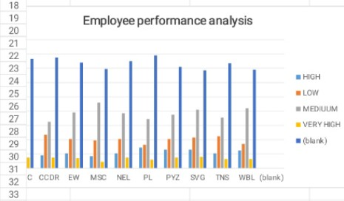
RESULTS
11

Slide 12
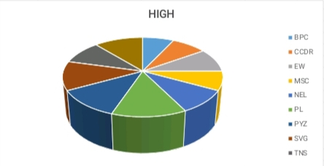
RESULTS

Slide 13
conclusion
Therefore the SVG business unit employees performs higher comparing to other units and whereas PL business unit performs lower comparing to other units.
Hence the SVG business unit employees works more efficiently and effectively comparing to other units according to the employee data given.

